Slide 1
Time Series: 6373
Unit 1: Conditions of Stationary and Basic Estimation

Slide 3
What is “Karate Kid Style”

Slide 9
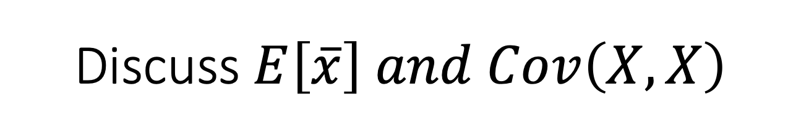
Discuss $E\left[\overline{x}\right] and Cov\left(X,X\right)$

Slide 10
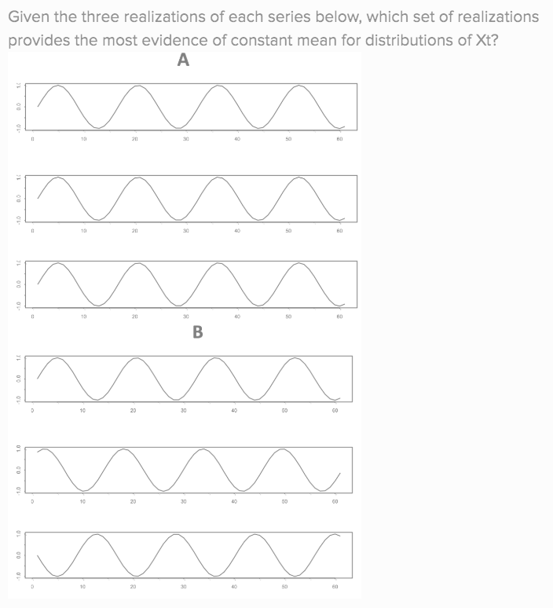
Review of Question 1.5.4

Slide 11
Break Out #1
Each of the next few slides have a plot of a time series and a description on them. Spend a few minutes reading and thinking about each one and then answer the following questions for each series:
Is the series stationary? If not, which of the 3 conditions is/are violated?
Is it practical / possible to obtain another realization? Are there any assumptions you would have to make to consider multiple realizations.

Slide 12
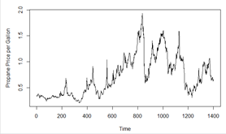
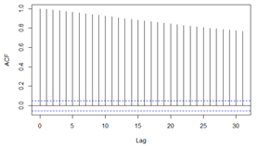
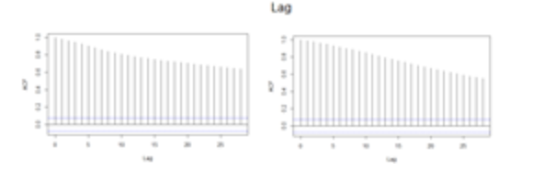
WEEKLY PROPANE PRICE PER GALLON
Description: This is a time series data set of the number of weekly Mont Belviue, TX propane prices per gallon from July 1992 to April 2019. The data is publicly available at the U.S. Energy Information Administration (EIA) website.

Slide 13
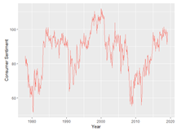
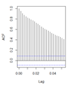
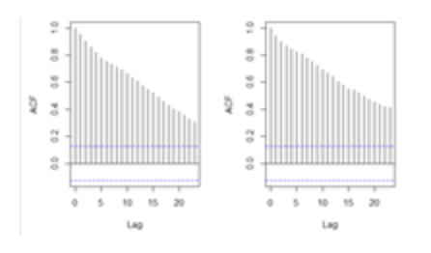
Monthly Consumer Sentiment 1978-2019
Description: This is a time series data set of consumer sentiment measured by the study from the University of Michigan: Consumer Sentiment [UMCSENT], retrieved from FRED, Federal Reserve Bank of St. Louis; https://fred.stlouisfed.org/series/UMCSENT, May 6, 2019.

Slide 14
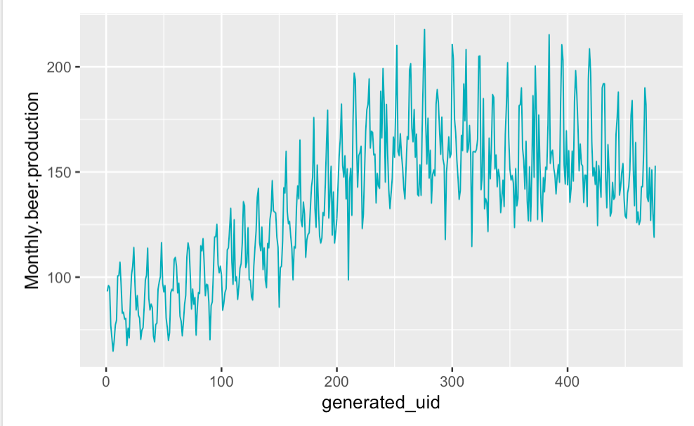
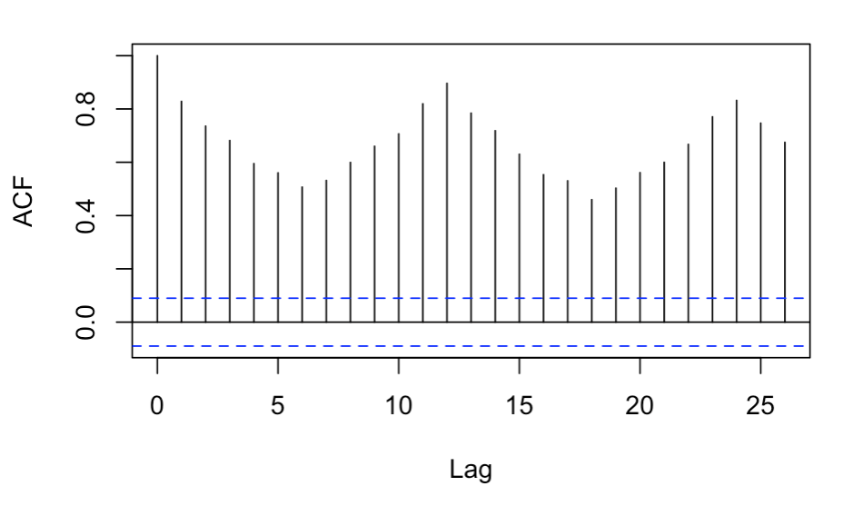
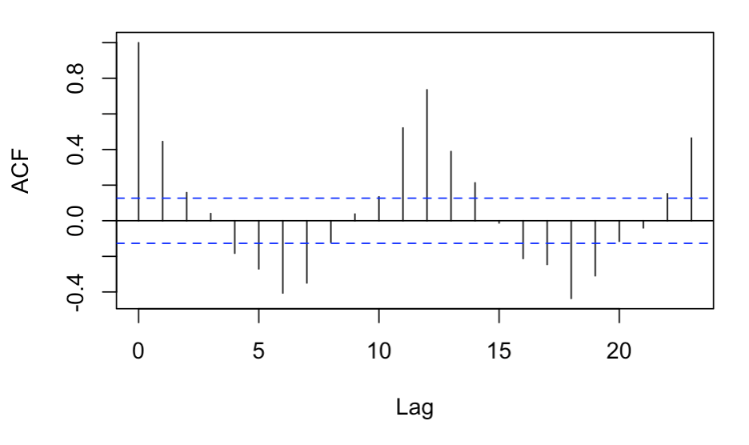
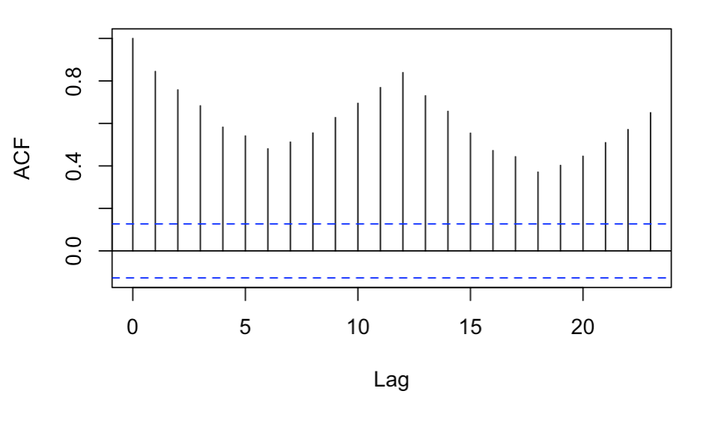
Beer Produced Monthly in Australia 1956-1995 (in megalitres)
Description: This is a time series data set of the amount of megalitres of beer produced in Australia from January 1956 to August 1995. The data is publicly available at https://www.kaggle.com/shenba/time-series-datasets#monthly-beer-production-in-austr.csv

Slide 15
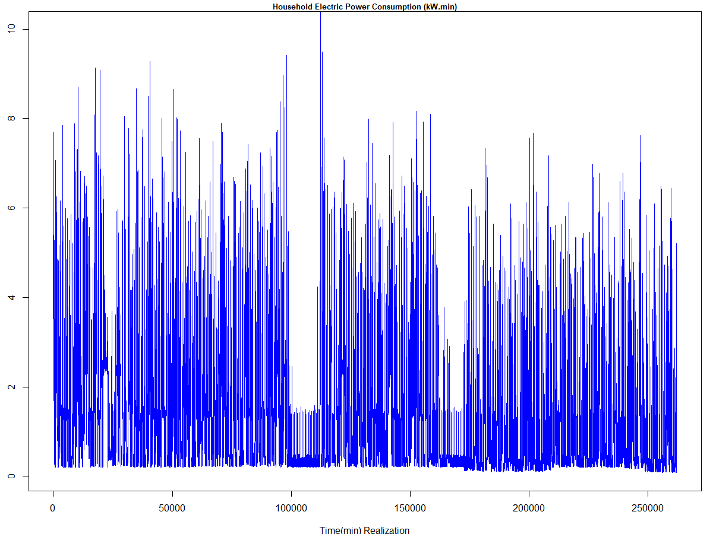
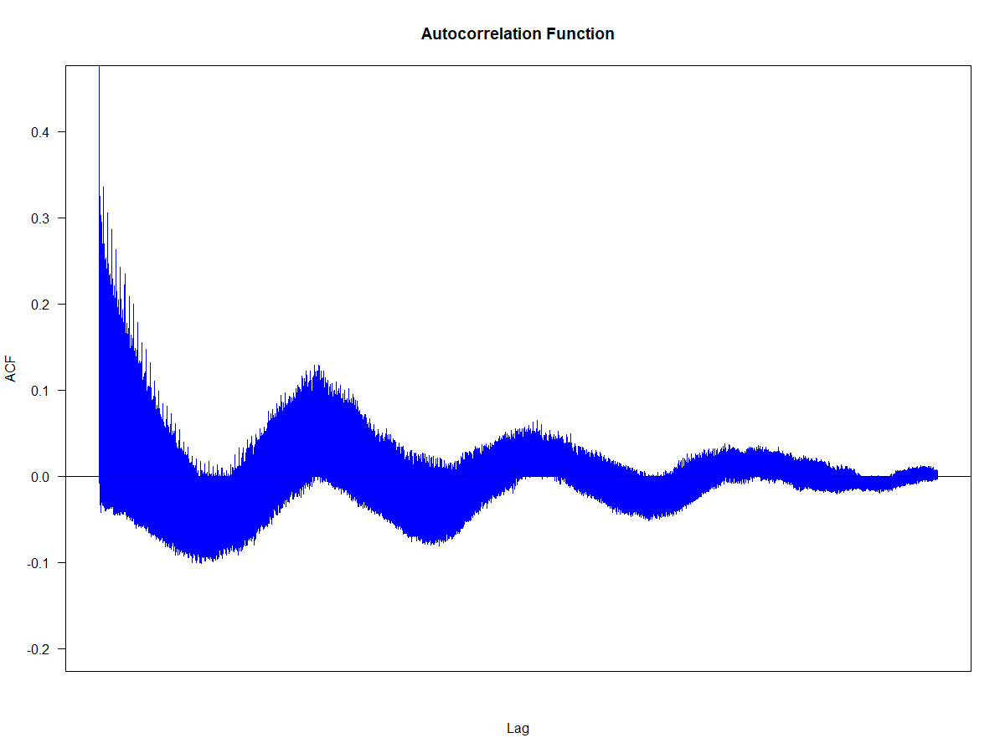
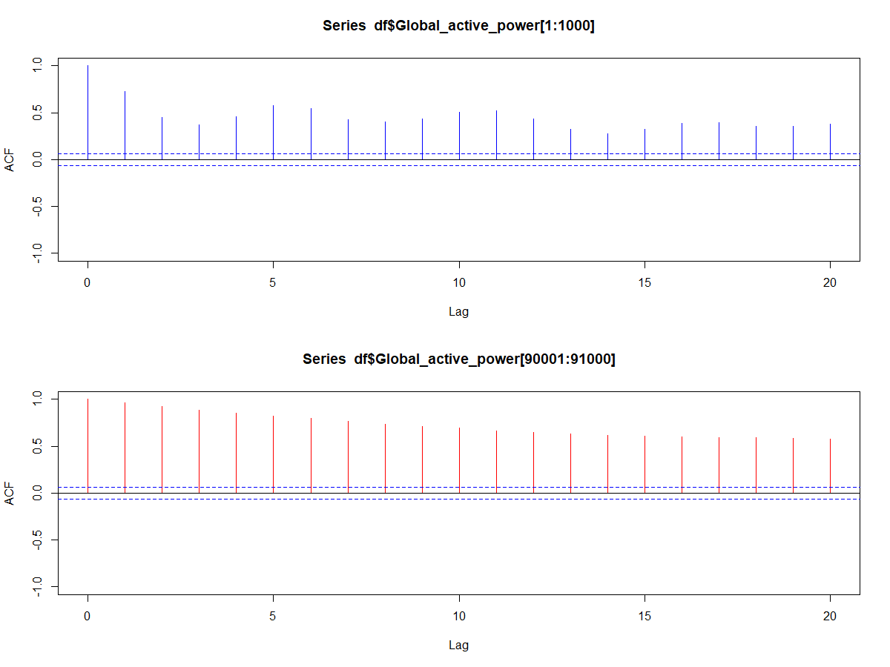
HOUSEHOLD ELECTRIC ENERGY CONSUMPTION (kW.min)
Description: This is a time series data set of electric power consumption for a household with one minute sampling rate from December 2006 to November 2010. The data is publicly available at UCI Machine Learning Repository https://archive.ics.uci.edu/ml/datasets/Individual+household+electric+power+consumption. Note: Although dataset includes 47 months of observations, for clarity, the graphic (Top) only displays 6 months.

Slide 16
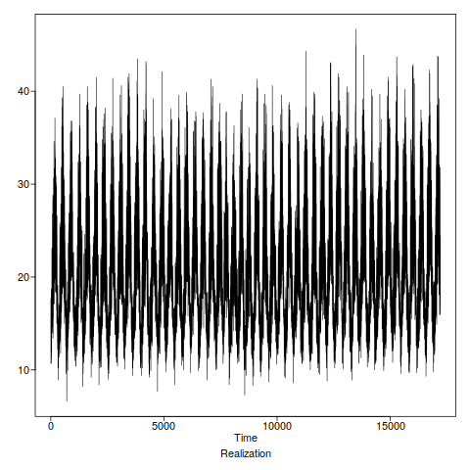
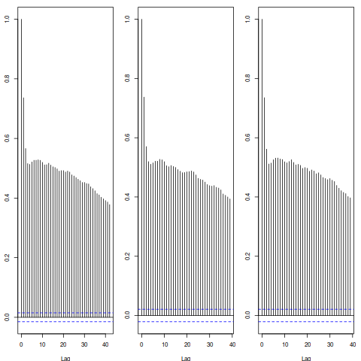
Maximum temperatures in Melbourne, Australia (Celsius)
Description: This time series data set contains the maximum daily temperature in Melbourne, Australia every day since january 1 1971. It is the highest temperature for the 24 hours prior to the observation, which was recorded at 9 am local time. It is publicly available here: http://www.bom.gov.au/jsp/ncc/cdio/weatherData/av?p_nccObsCode=122&p_display_type=dailyDataFile&p_startYear=&p_c=&p_stn_num=086077
Complete
First Half
Second Half

Slide 17
End Break Out 1

Slide 18
Break out 2
Take turns describing your realization that you posted on the Google Doc and address the three conditions of stationarity.

Slide 19
End Break Out 2

Slide 20
Break Out 3
Run through the following code from the asynch on the next slide and make sure everyone in your understands the code and the output (the confidence interval) and how to interpret it.
If you have time afterwards, got to the slide after that and discuss the difference between the two calculations of gamma_k (the autocovariance at lag k).
Finally, go to the final slide with the plot and discuss the behavior of the two estimators and which one is preferred.

Slide 21
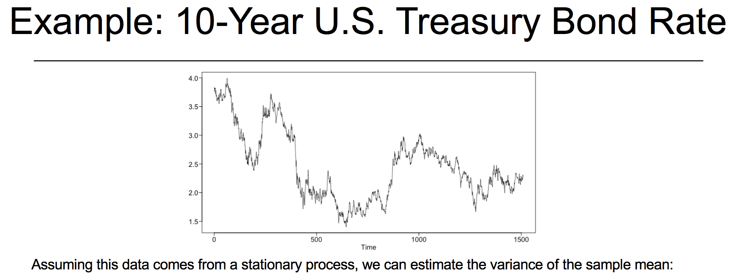
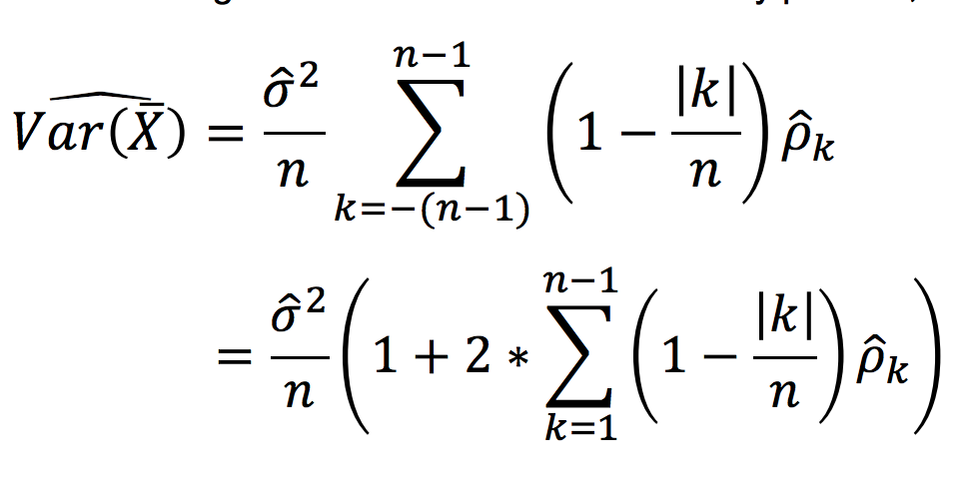
Variance Code
xdf = read.csv(file.choose(),header = TRUE)
x = as.numeric(paste(xdf$Adj.Close))
x = x[!is.na(x)]
n=length(x) #n = 2014
nlag=2013 #n-1
gamma0=var(x)*(n-1)/n
aut=acf(x,lag.max=nlag) #n-1
sum=0
for (k in 1:nlag) {sum=sum+(1-k/n)*aut$acf[k+1]*gamma0}
vxbar=2*sum/n+gamma0/n #note the mult of sum by 2
vxbar

Slide 22
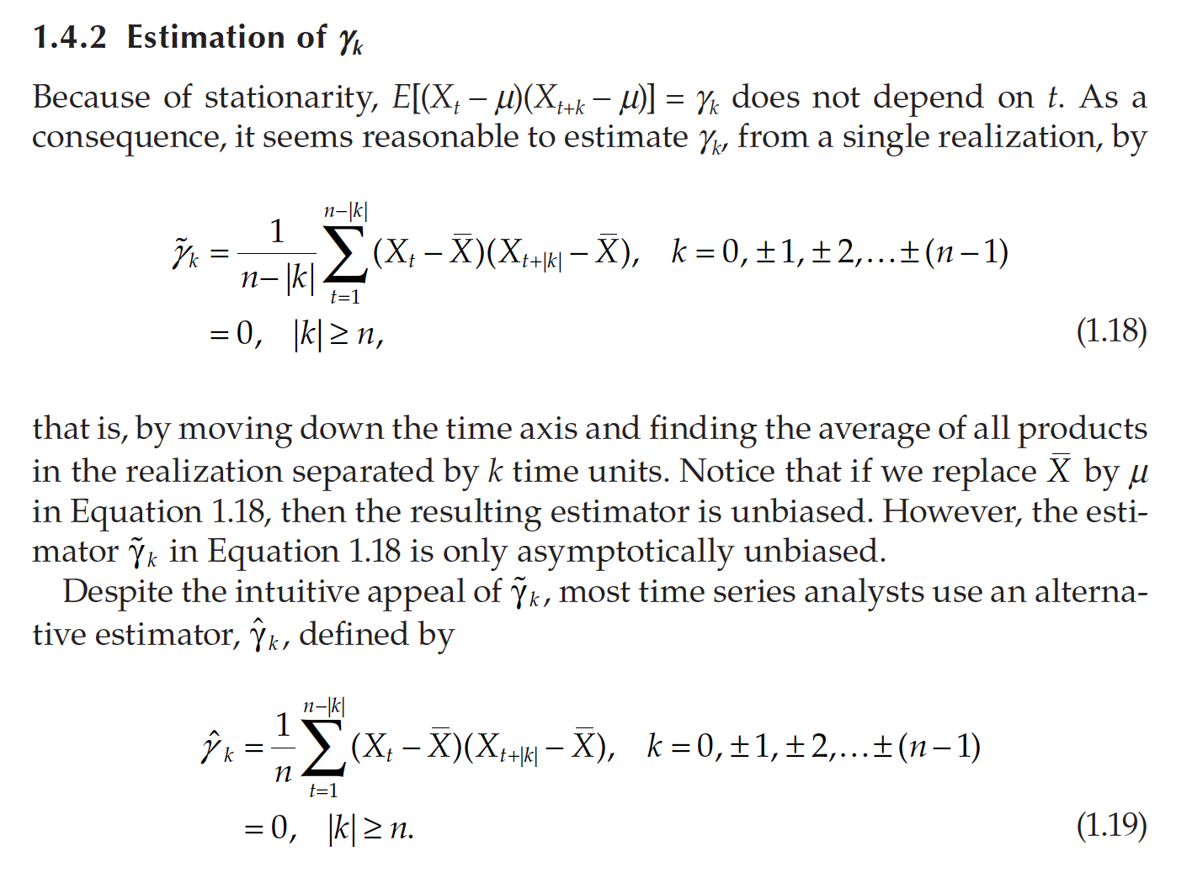
Estimation

Slide 23
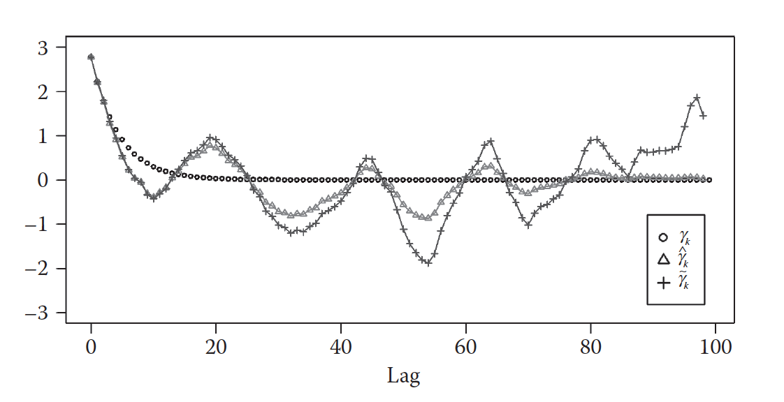
Estimation of Autocovariance

Slide 24
End Break Out 3

Slide 25
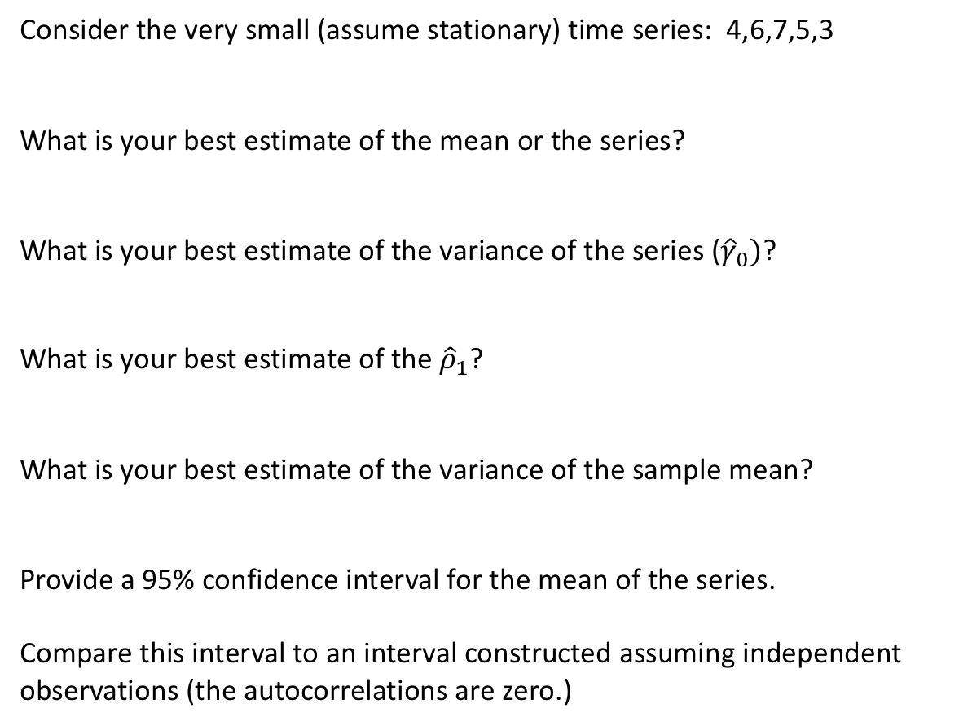
Break Out 4 (If Time in class.)
Consider the very small (assume stationary) time series: 4,6,7,5,3
What is your best estimate of the mean or the series?
What is your best estimate of the variance of the series (${\hat{γ}}_{0})$?
What is your best estimate of the ${\hat{ρ}}_{1}$?
What is your best estimate of the variance of the sample mean?
Provide a 95% confidence interval for the mean of the series.
Compare this interval to an interval constructed assuming independent observations (the autocorrelations are zero.)

Slide 26
End Break Out 4

